Slide 1

Find a friend. Date a friend. Why strangers?

Slide 2
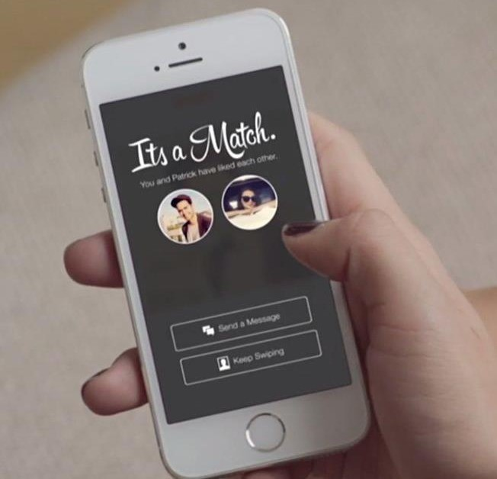
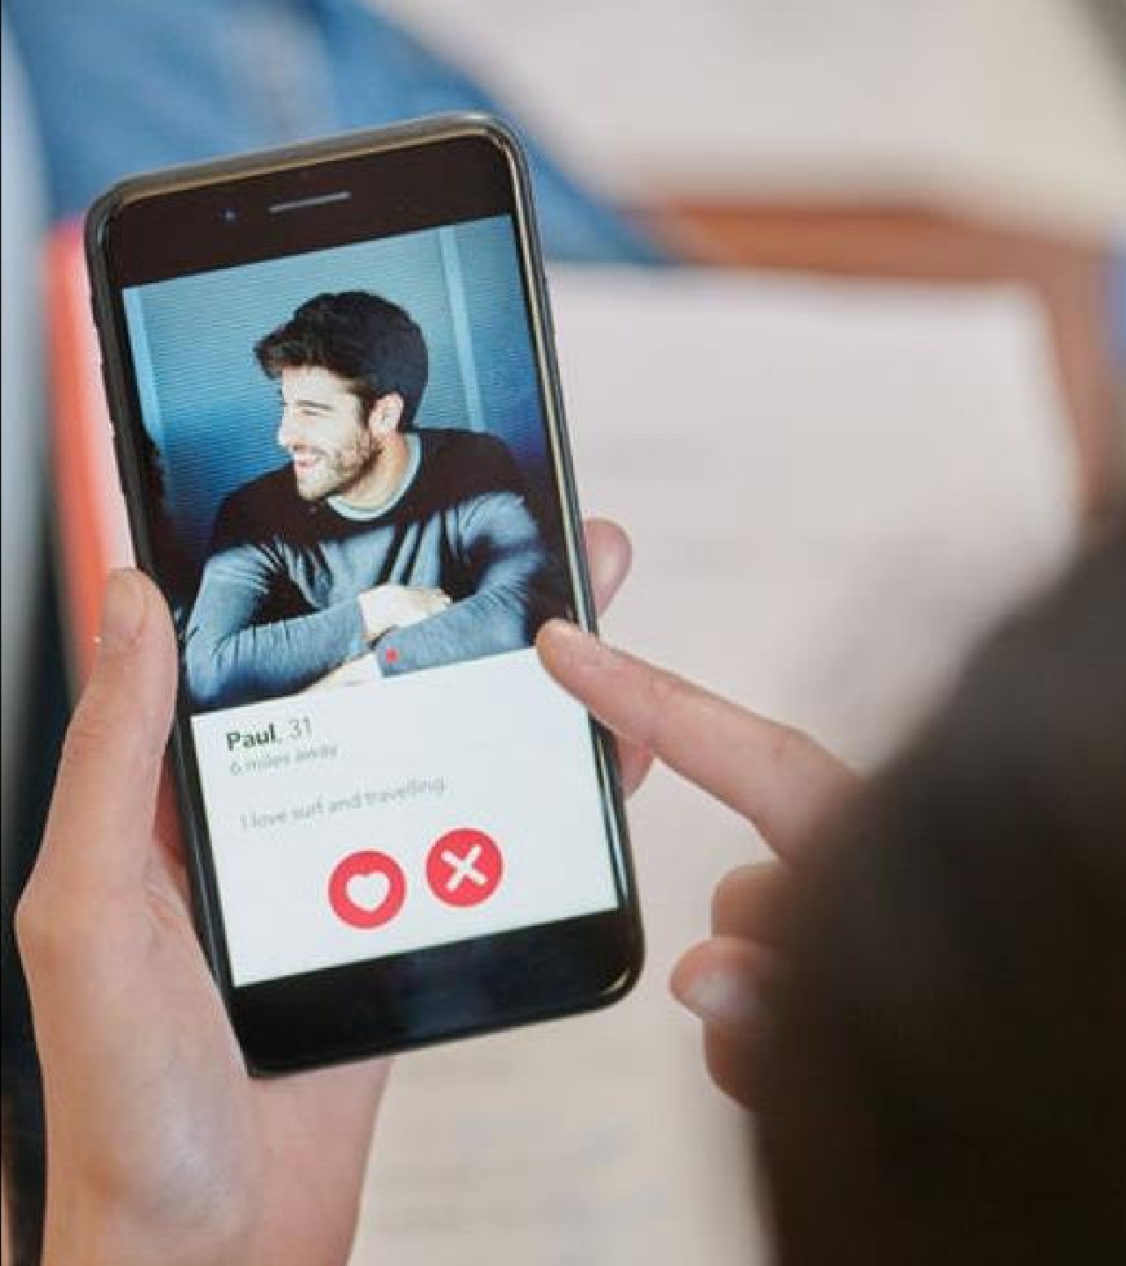
Introducing
The First
Socio-Dating App
BeYu is the first one of its kind , a socio-dating app that provides matches with friends or with mutual friends only therefore no matching with strangers anymore with a proper authenticity of data and one can see the profile before sending a match and networking socially at the same time thus making more friends.

Slide 3
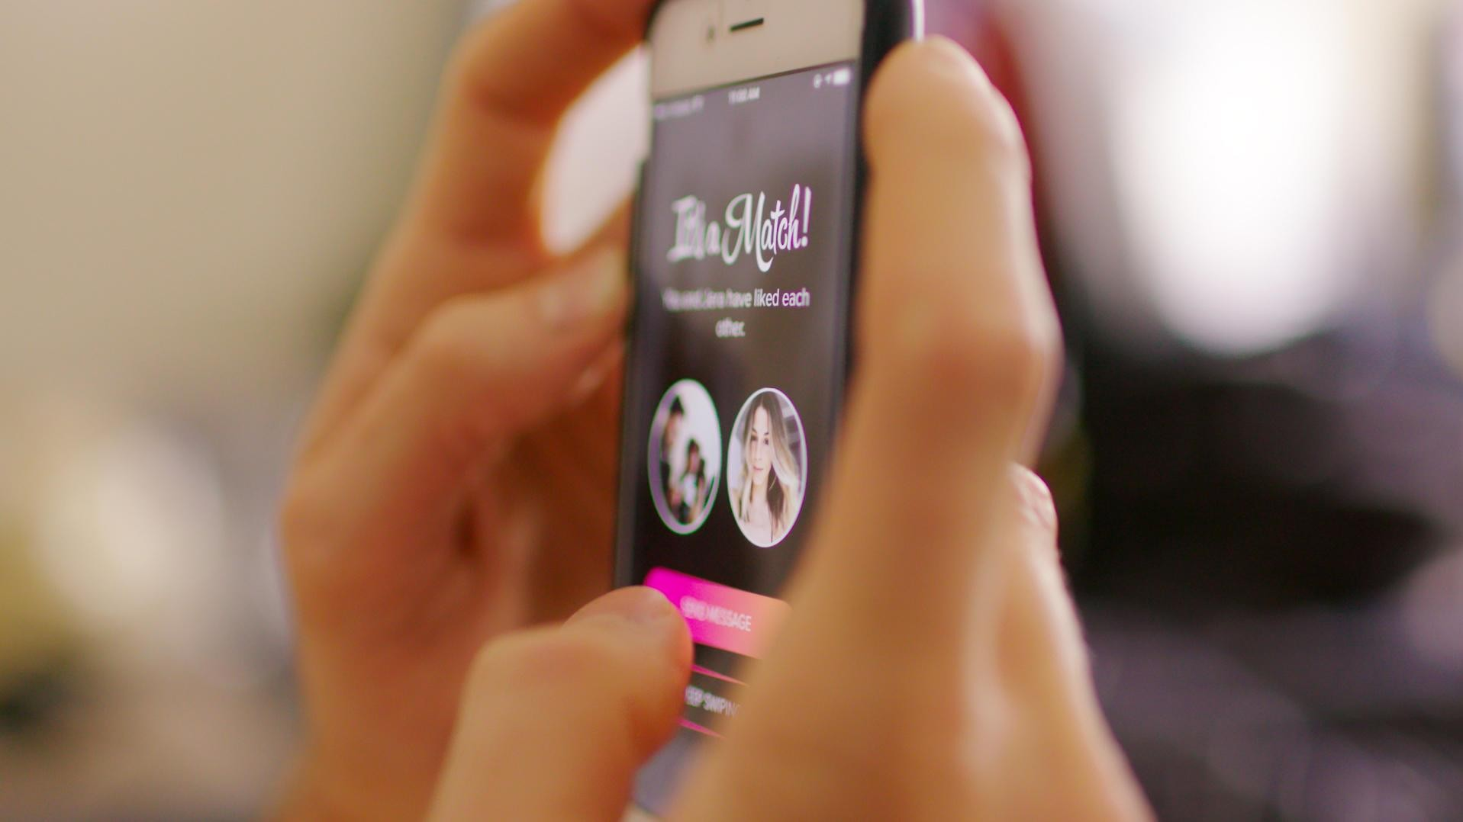

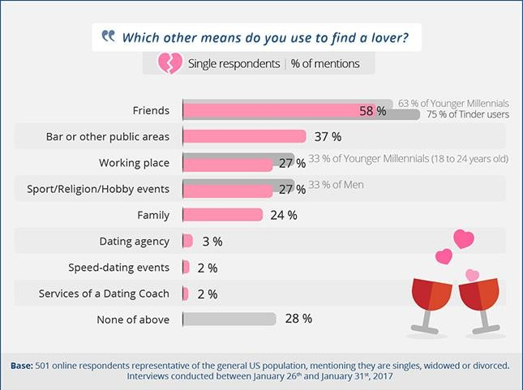
What is the Problem?
Is there any platform that enables match making within the peer or mutual friend circle?
- Users usually land up on online dating apps to look for a meaningful relationships and to expand their social circles. But are the existing dating platforms the right place to build this socio circle?
- Existing Application or platforms provide match making only with strangers. What if one wants a match within his/her social circle!?
Friends (58%) + Family (24%) = 82% Need BeYu

